Slide 1
Computer Vision Case Study: Deep Learning for Satellite Imagery and Land Cover Statistical Estimation
Francesco Pugliese, PhD
neural1977@gmail.com
Notes:
1

Slide 2
Outline
Goal
Land Cover (LC) statistics and maps represent a critical statistical product, for Official Statistics, for example. Since they require a big effort to be created, the underlying idea is building an automatic and efficient system that processes satellite images in order to generate:
Automatic Land Cover Maps
Automatic Land Cover Estimates
Methodology
New Approach: using Deep Learning techniques to generate Land Cover maps (classification and segmentation through CNN and U-Net).
Results
A Deep Learning-based integrated (CNN + U-Net) and automated architecture that gives accurate results for all LC classes
1

Slide 3
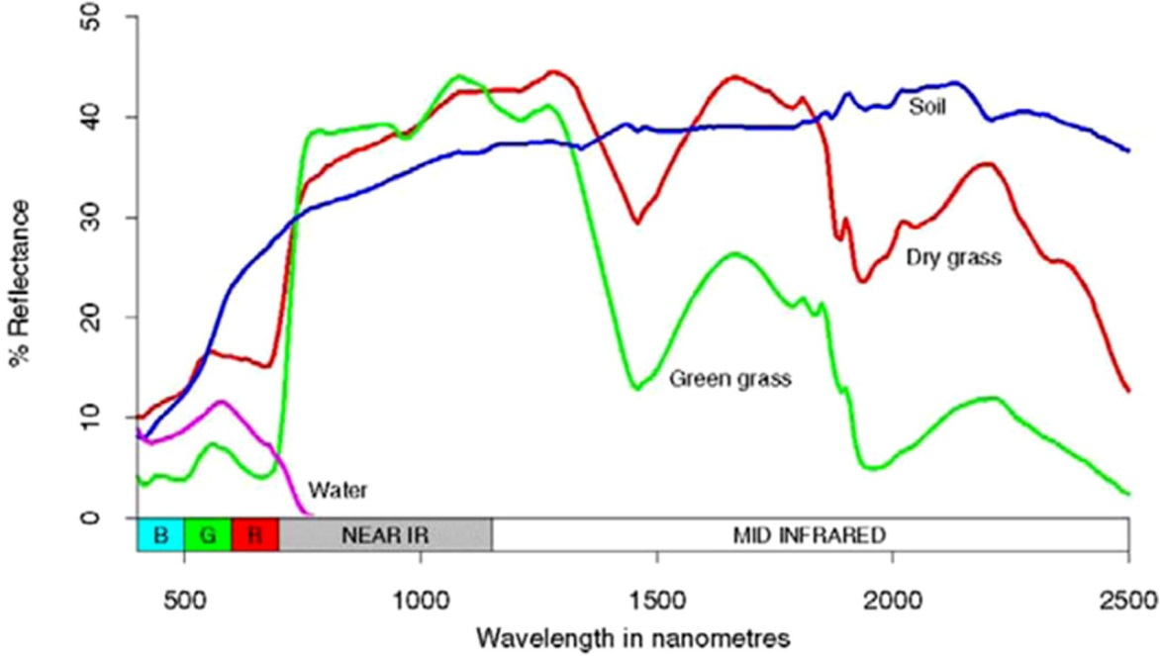
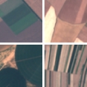
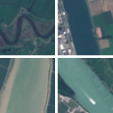
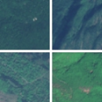
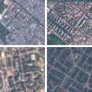
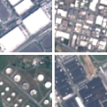
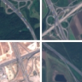
Deep Learning for Land Cover from Satellite Imagery
Standard approach: Spectral Signature
New approach: Computer Vision (Deep Learning)
ANNUAL CROP
RIVER
FOREST
RESIDENTIAL
INDUSTRIAL
HIGHWAY
Different LC classes have different reflectance spectra
Different LC classes have different spatial/visual patterns
Patterns of Reflectance Variation are used to predict LC classes
A Trained ML algorithm predicts the LC class independently
Decision on each data point does not depend on neighboring data points
The Variation of visual/spatial patterns is used to predict LC classes
Trained ML algo (CNN) predicts the LC class of image pixels based on information from neighboring pixels
Decision on each pixel depends on the whole sub-image (tile) the pixel belongs to
2

Slide 4
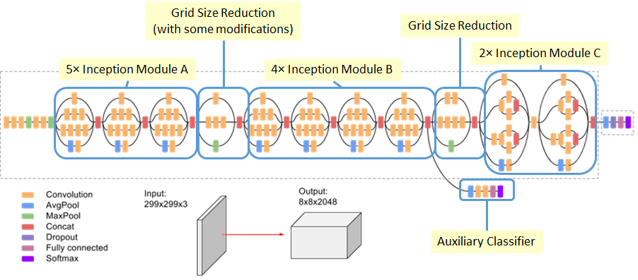
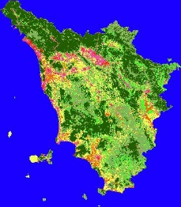
Machine Learning for LC from satellite imagery
TRAINING DATASET
The Training.set affects the classification and prediction accuracy of our machine learning algorithm. We have harnessed the EuroSAT dataset features and its EuroSAT Land-Cover classification. EuroSAT is made of satellite imagery which is carefully collected and selected from Sentinel 2 Satellite Copernicus Project.
INPUT
Input images to be processed, must be in excellent agreement with training pictures. That’s why we take portions of Italy satellite imagery from Sentinel 2 itself.
ARCHITECTURE
We chose our Algorithm Architecture accordingly: Classification Convolutionary Neural Network (CNN) or Segmentation Convolutionary Neural Networke (U-Net). We built the model by selecting the right hyper-parameters, optimizations and validations.
OUTPUT
The output ground truth is within the training dataset in order to validate the model. Then, the ouput is yielded by processing the Input dataset in order to perform classifications/predictions.
3

Slide 5
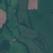
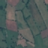
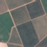
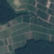


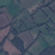
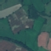
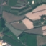
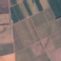
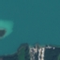
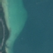
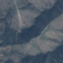
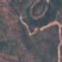
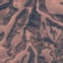
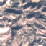
CNN: Satellite Imagery Dataset
ANNUAL CROP
RIVER
FOREST
EuroSAT dataset (https://github.com/phelber/eurosat):
Based on Sentinel-2 satellite images
27000 geo-referenced and labeled image patches (each one of 64x64 pixels)
10 different Land Use and Land Cover classes, with 2000-3000 images per class
RGB (8-bit) and Multi-Spectral (13 spectral bands, 16-bit) versions available
RESIDENTIAL
INDUSTRIAL
HIGHWAY
PASTURE
PERMANENT CROP
SEA LAKE
HERBACEOUS VEGETATYION
4

Slide 6
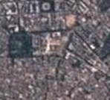
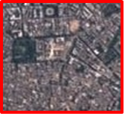
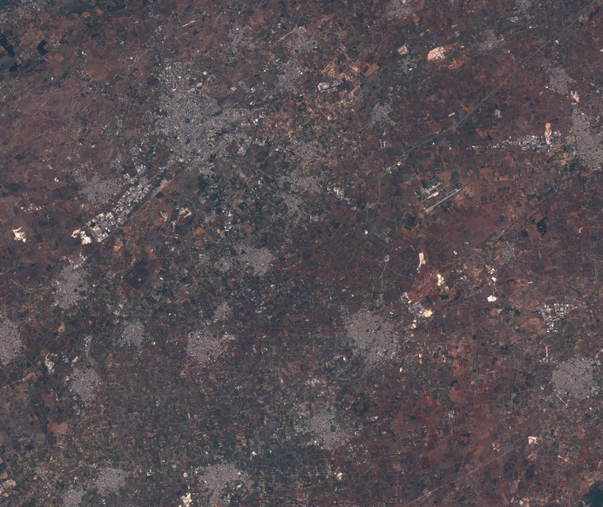
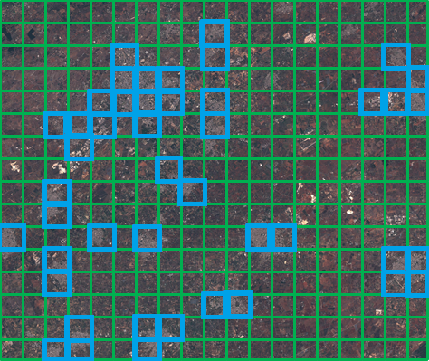
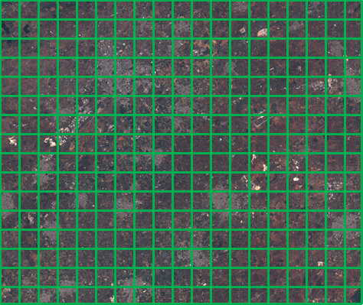
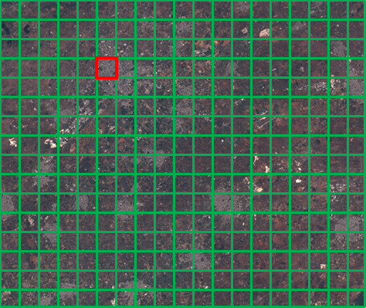
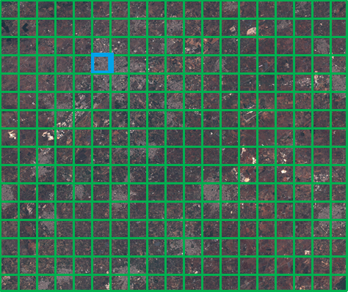
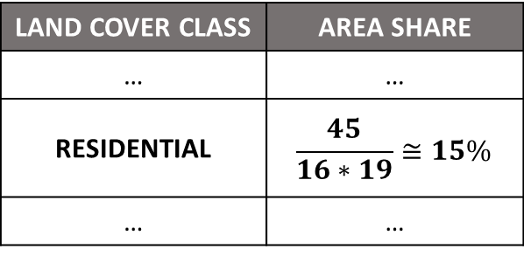
CNN: Inception-V3 Architecture
Classify-and-Count
Approach
RESIDENTIAL
Input satellite image
6

Slide 7
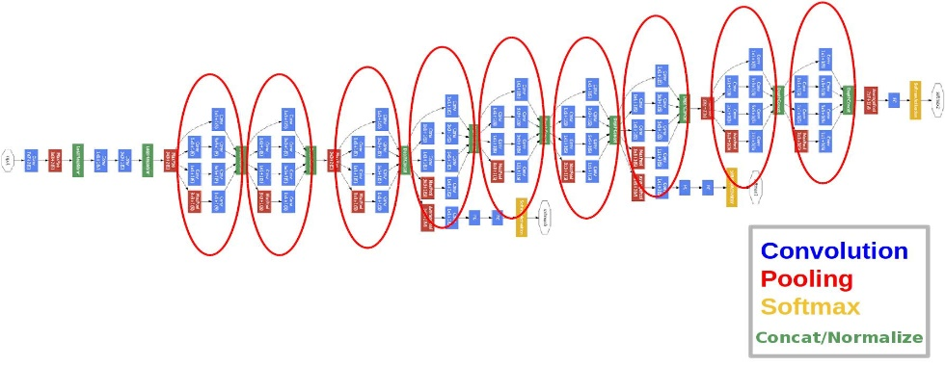
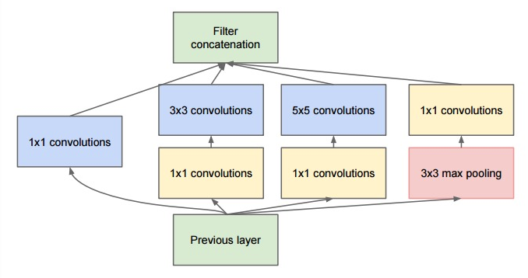
GoogleNet – Google (Szegedy, C., et al., 2015)
Critical Feautures (Szegedy, C., et al., 2015):
Computationally Effective Deep architecture: 22 layers
Why the name inception, you ask? Because the module represents a network within a network. If you don't get the reference, go watch Christopher Nolan's “INCEPTION”, computer scientists are hilarious.
Inception: it isbasically the parallel combination of 1×1, 3×3, and 5×5 convolutional filters.
Bottleneck layer: The great insight of the inception module is the use of 1×1 convolutional blocks (NiN) to reduce the number of features before the expensive parallel blocks.
Upside: 4 millions parameters!
Downside: Not scalable!
Results:
7 Models Ensemble : 6.67% Top-5 Error.
7

Slide 8
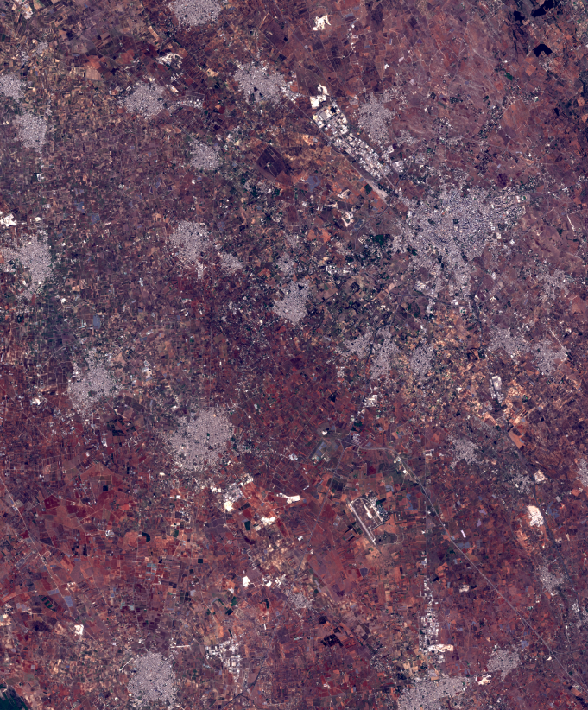
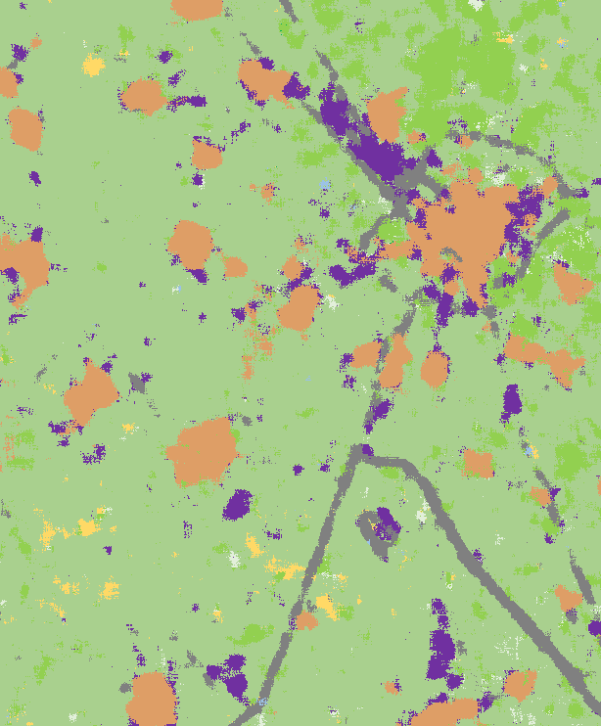
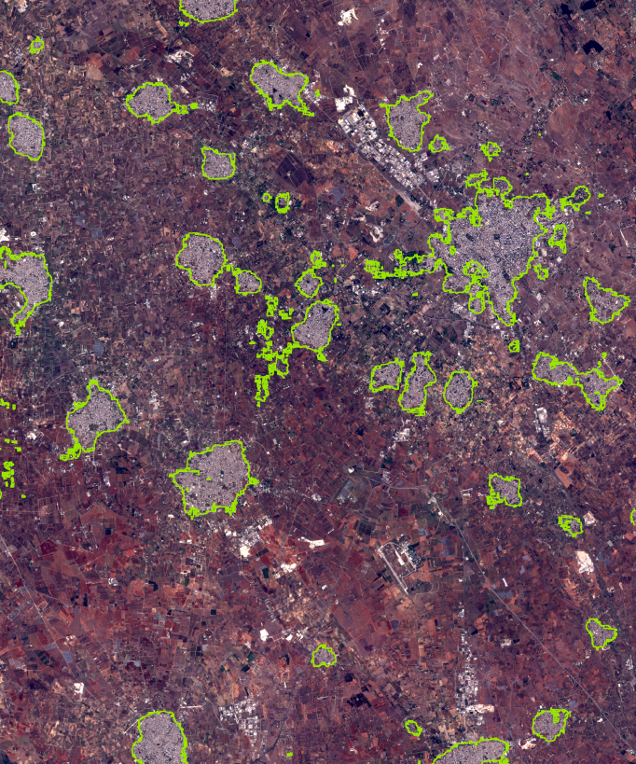
CNN: Example of Automatic Land-Cover Map
[A] Input Lecce’s picture (751 km²)
[B] Related Lecce LC Map (output)
[C] Depiction of the Residential class generated by overlapping [A] and [B]
8

Slide 9
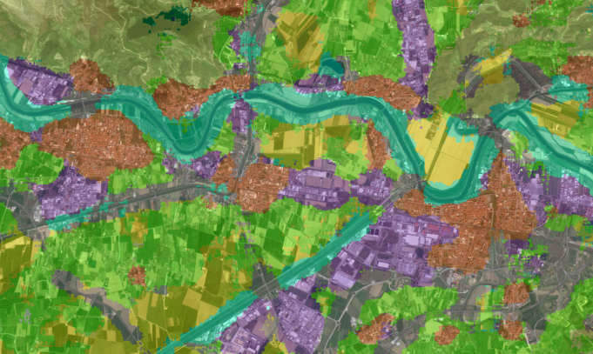
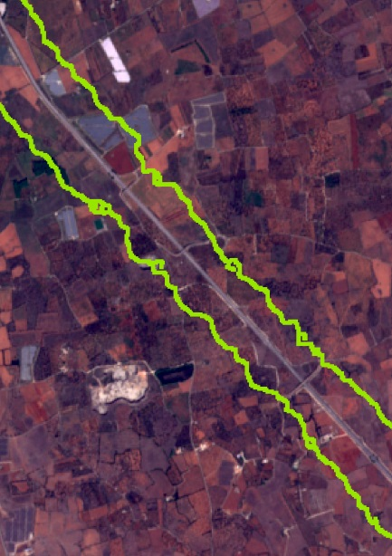
CNN: Over-estimation effect of River and Highway classes
~500 m
~600 m
[D] Detailed overview of the Arno River pathway (Pisa, 443 km²) on top of a semi-transparent version of the corresponding LC map.
[E] Fragment of Lecce highlighting the border of the Highway class predicted by the model. We can see the extent of the over-estimation
9

Slide 10
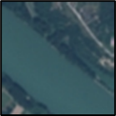

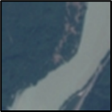

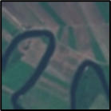

U-Net: Dataset creation
EuroSAT Imagery
River
Segmentation Masks
River
The dataset creation to train the U-Net segmentation model was performed by exploting satellite pictures from River class by EuroSAT and data from the Copernicus High Resolution Layer.
For each image we determined a label consisting in a mask keeping track of the class information for every pixel:
0 means the pixel belongs to River class (black)
1 means the pixel does not belong to River class (white)
Main difference with the Standard (Classification) CNN Dataset: in classification, the class label refers to the whole image and not to each single pixel such as in segmentation stage.
Final dataset: 1500 segmentartion masks validated.
Implementation of a similar training dataset for Highway thanks to Open Street Maps data.
10

Slide 11

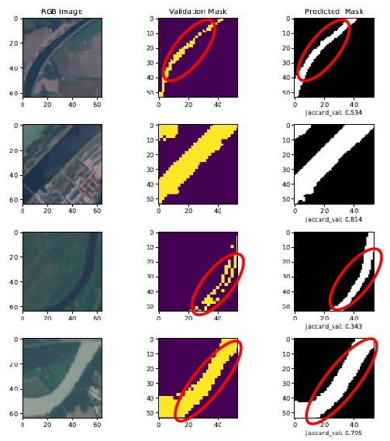
U-Net: Architecture
Completion abilities of U-Net
Skip-connections
Strati Convolutivi Trasposti (Up-sampling)
Strati Max-pooling
11

Slide 12
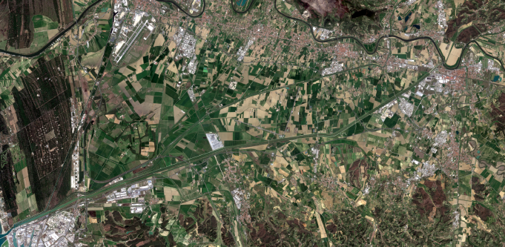
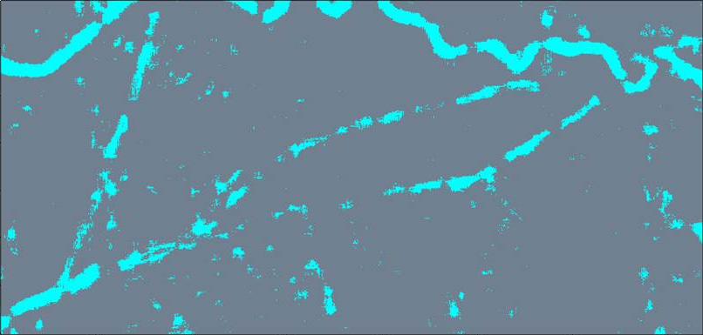
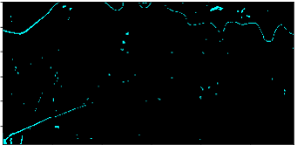
U-Net: adjustment of the over-estimation issue in “thread-like” classes such as River
Classification by means of CNN
U-Net Segmentation
12

Slide 13
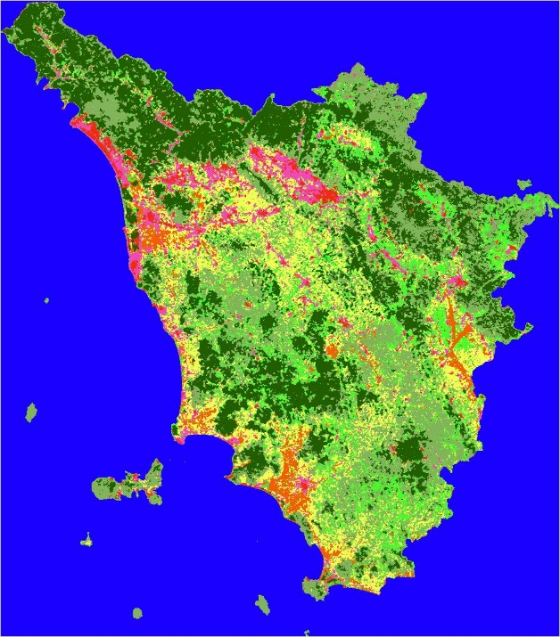
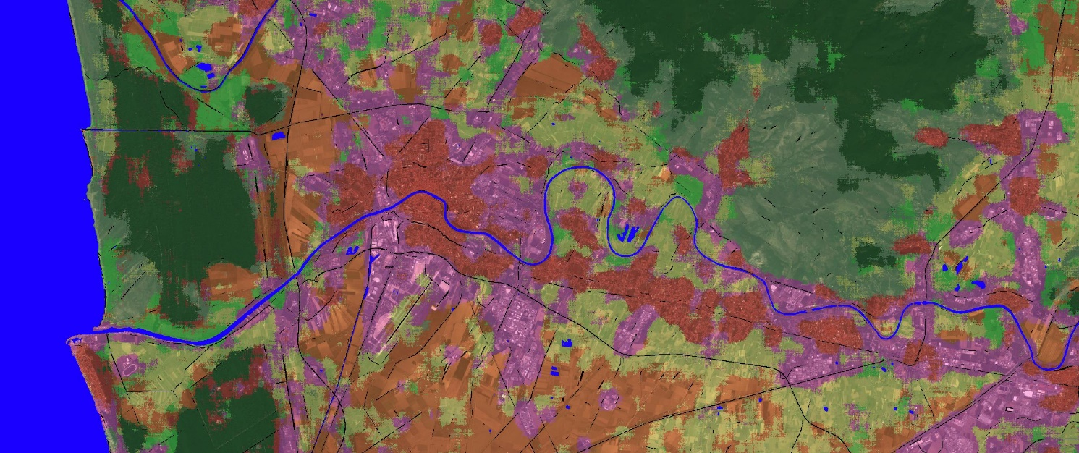
Integrated Map CNN + U-Net
River
Herbaceus
Industrial
Pasture
Annual Crop
Forest
Residential
Permanent Crop
Highway
Detail of Arno river view (Pisa, 443 km²) overlapped to a semi-transparent version of the corresponding map coming from the CNN and U-Net integration process. Different colours refer to different LC classes.
Tuscany LC Map
Integrated system (CNN + U-Net) works perfectly with all the LC classes
U-Net predicts River and Highway.
Whereas CNN classifies the other classes with are left over.
13

Slide 14
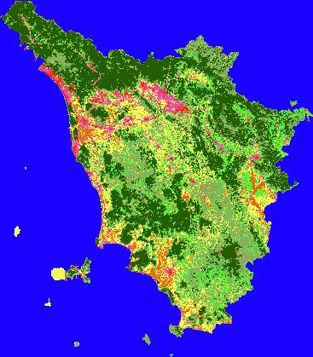
Example of integrated (CNN+U-Net) LC map and statistics
CNN + U-Net:
LC CLASS | COVERAGE %
Annual Crop | 4.1
Forest | 34.1
Herb. Vegetation | 27.2
Highway | 0.7
Industrial | 5.2
Pasture | 10.6
Permanent Crop | 14.6
Residential | 2.4
River | 1.6
Land Cover map of Tuscany
14

Slide 15
Land Cover System – Pipeline Architecture
TRAINING STAGE
INFERENCE STAGE
EuroSAT Training Set
UNET Training Set (Rivers+Highways)
Sentinel-2 Picture
Preprocessing
Preprocessing
Classify-and-Count by CNN
Segment-and-Count by UNET
CNN – Inception V3
Training
UNET
Training
8 classes Map and Statistics
2 classes Map and Statistics
CNN model saved
UNET model saved
Merged Map and Statistics
15

Slide 16
References
Bernasconi, E., Pugliese, F., Zardetto, D., & Scannapieco, M. (2019). Satellite-Net: Automatic Extraction of Land Cover Indicators from Satellite Imagery by Deep Learning. New Techniques and Technologies for Statistics (NTTS) 2019.
Bernasconi, E., De Fausti, F., Pugliese, F., Scannapieco, M., & Zardetto, D. Automatic extraction of land cover statistics from satellite imagery by deep learning. Statistical Journal of the IAOS, (Preprint), 1-17.
Helber, P., Bischke, B., Dengel, A., & Borth, D. (2019). Eurosat: A novel dataset and deep learning benchmark for land use and land cover classification. IEEE Journal of Selected Topics in Applied Earth Observations and Remote Sensing, 12(7), 2217-2226.
7

Slide 17



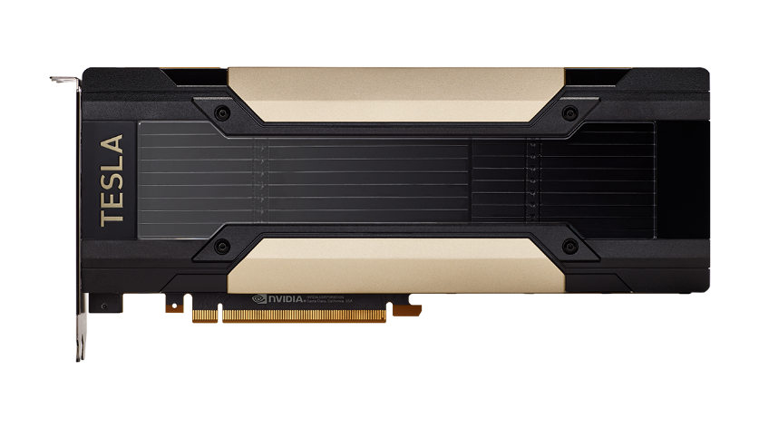



Azure Wishlist
1) Hadoop and Spark to fasten pre-processing and post-processing with different cloud nodes
2) More GPUs like Tesla V100 or better to optimize Deep Neural Networks parallelization and speed up Training and Testing
3) Backup systems to save data, models and code
4) Cognitive services for Computer Vision and NLP tasks
16

Slide 18
Thank you for your attention
Francesco Pugliese
Notes:
18

